Slide 1
Epidemic Eradication
Parallel Games

Slide 2
Genre
Survival
Shooter
Multi-directional shooter

Slide 3
System Requirements
PC
OS: Windows 7 SP1+, macOS 10.11+, Ubuntu 12.04+, SteamOS+
Graphics card with DX10 (shader model 4.0) capabilities
CPU: SSE2 instruction set support

Slide 4
Game Play/Mechanics
2D
Real Time
Top-down
Mouse/Keyboard combo input

Slide 5
Game Story
You are playing as an antibody who is eradicating foreign invaders such as bacteria and virus. See how long you can survive without getting infected.

Slide 6
Game Controls & User Interface
W – forward movement
S – backward movement
A – leftward movement
D – Rightward movement
Mouse (Movement) – Aim
Mouse (Left Click) - Shoot

Slide 7
Replayability
Our game will have a level system, different scenes, high score ranking system, and take place inside the human body (large opportunity for new levels/ideas).

Slide 8

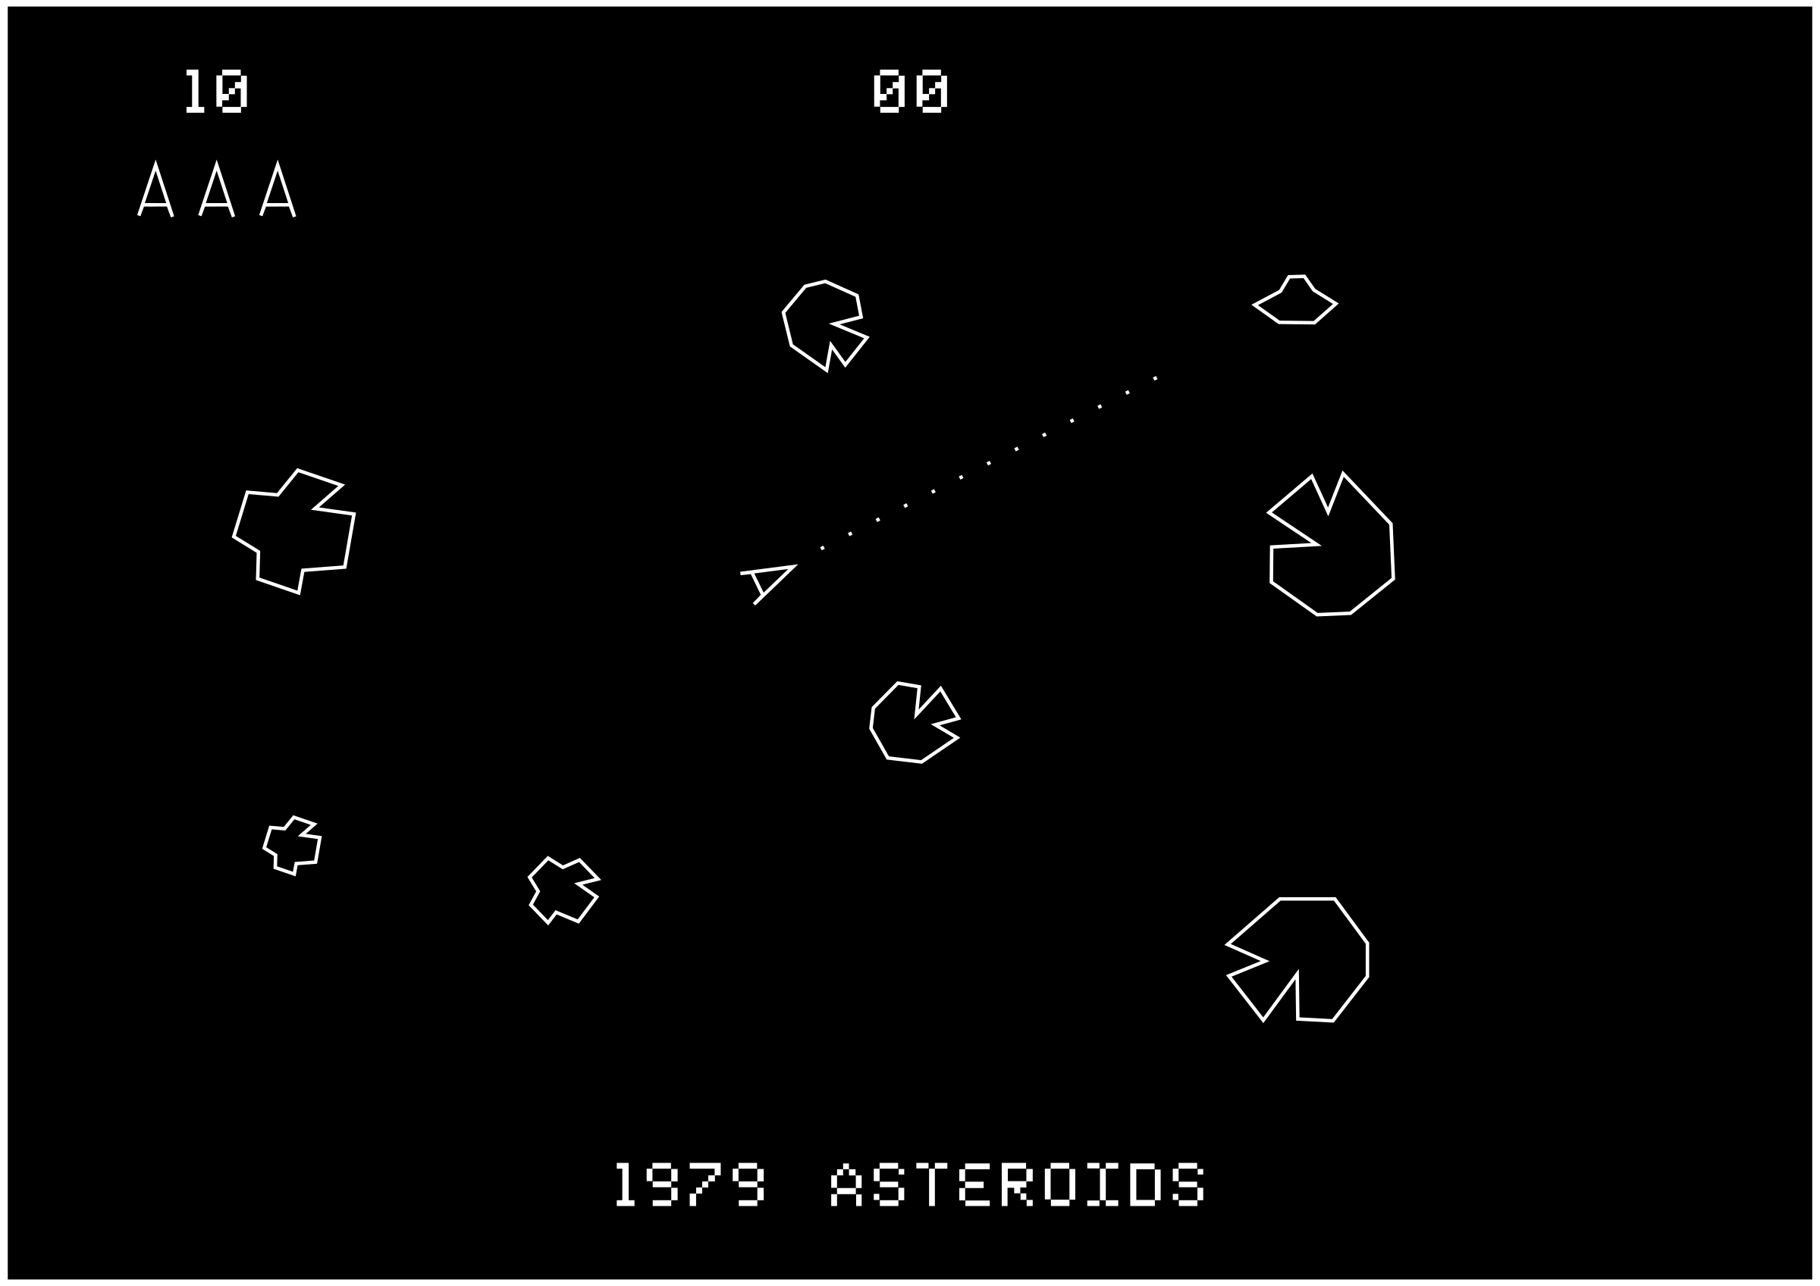
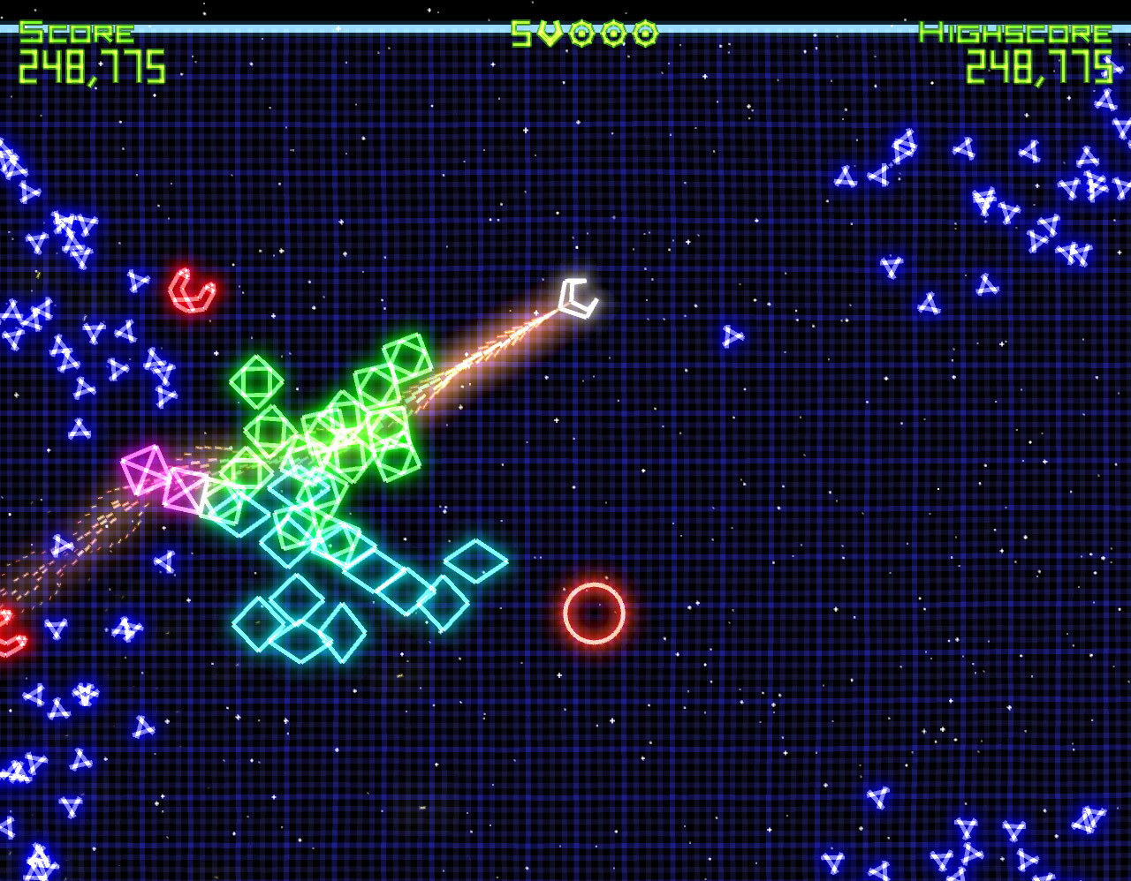
Inspiration & Examples
Asteriods (1979)
Geometry Wars

